Slide 1
BDD for iOS @ Philips CDP²
Jean Herfs & Maarten van der Velden
Connected Digital Platforms & Propositions
22 September 2016

Slide 2
Who’s listening?
Notes:
J: Questions: Who is the audience, kind of devs, think about BDD, etc. TDD vs BDD??

Slide 3
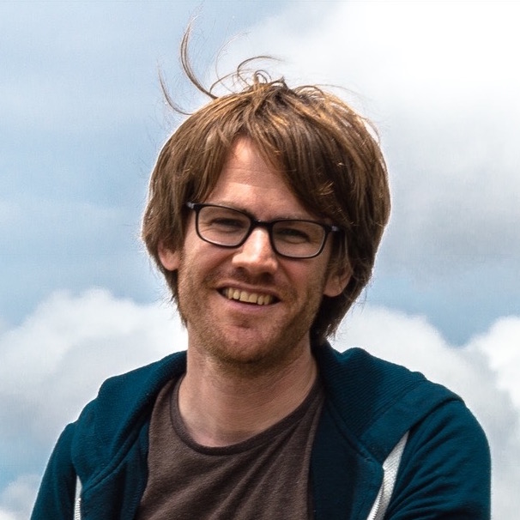
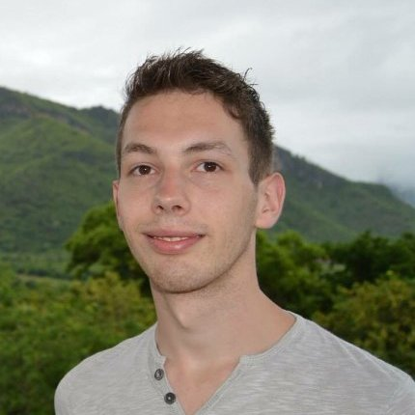
About us
XP
BDD
TDD
Clean Code
Agile
Scrum
Computer Vision
Web Development
Artificial Intelligence
Android
Data Mining
Reactive Programming
MatLab
Bluetooth
Calabash
Xamarin
Maarten van der Velden
Jean Herfs
Machine Learning
Interface Design
Swift
Java
UX
Connectivity
Objective-C
iOS
IoT
C# .NET
Notes:
J: CDP, focus on high quality code, medical grade software

Slide 4
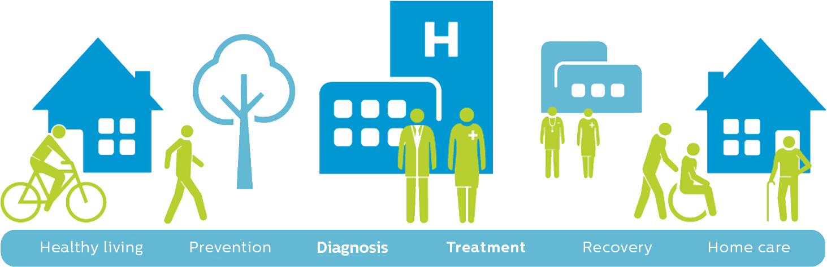
Philips HealthTech

Slide 5
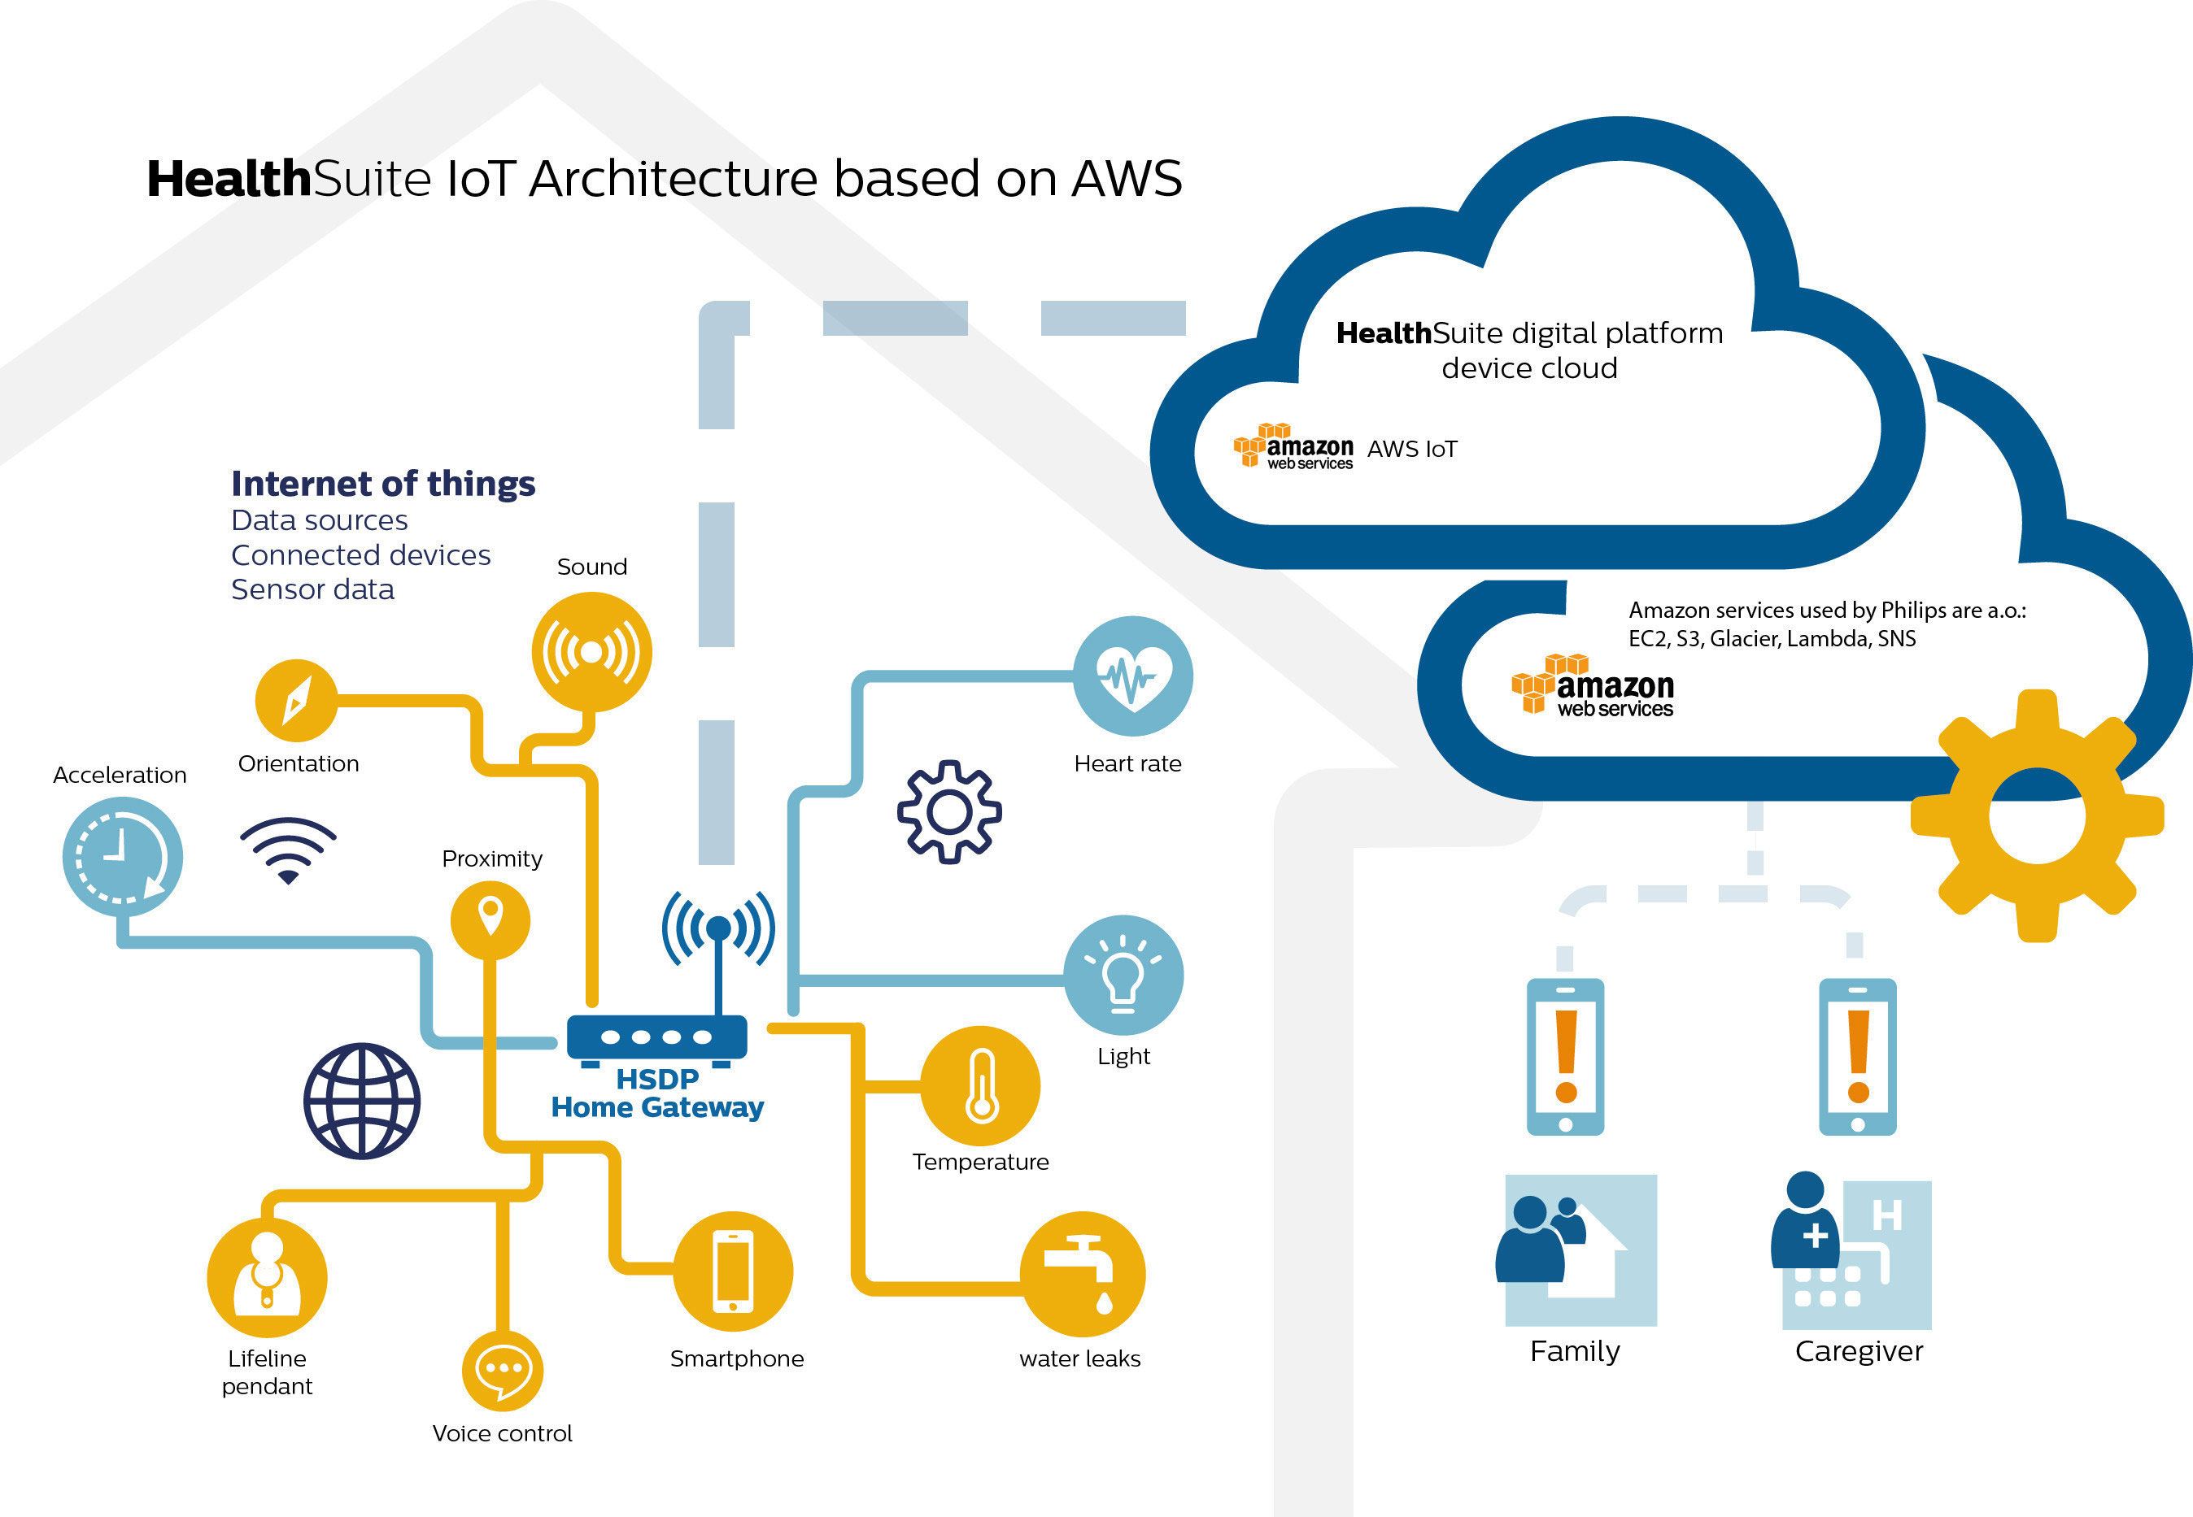
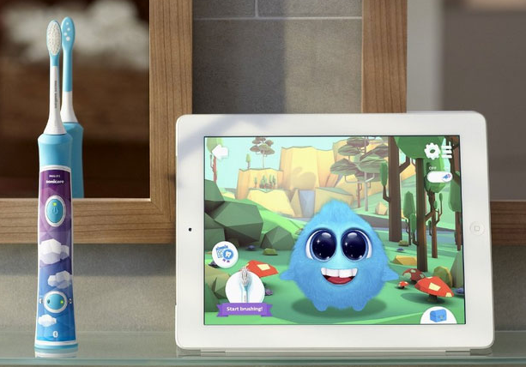
Philips Connected Digital Platforms & Propositions

Slide 6
Why Behavior Driven Development?
TDD + way of thinking + more descriptive
Feature level verification & traceability
More fun
Notes:
J:

Slide 7
The Challenge
Prevent regression, ensure quality, fast feedback (no manual labor)
Notes:
J:

Slide 8
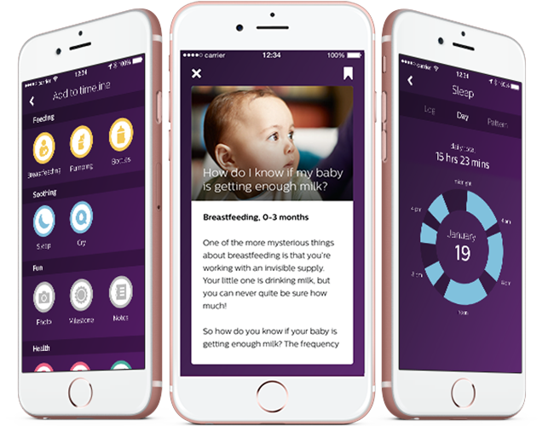

How we do it
Notes:
Tell the uGrow proposition story, explain medical challenges, explain drive for quality
M: Add uGrow logo, Specta/Expecta to make unit testing nice and easy
Calabash for BDD -> verification/integration testing

Slide 9
Gherkin Feature
@F123 @US456 Feature: [F123] The user wants to store consents in the backend Scenario: TC789: The user wants to store consents in the backend Given I am logged in with a clean user account When I am on the consents screen And I scroll down until I see the agreeAll switch And I switch the agreeAll on And I scroll down until I see the saveEntry button And I touch the saveEntry button And I wait until I see the userprofile screen Then the consents were stored in the backend

Slide 10
Implementation
And(/^the consents were stored in the backend$/) do ConsentsBackend.wait_for_stored_consents end
class ConsentsBackend < Backend def self.wait_for_stored_consents WaitUtil.wait_for_condition('Has consents in the backend', :timeout_sec => 8) do url = "#{DATA_SERVICE}/some/endpoint" response = get url consents = JSON.parse response valid_consents = are_consents_valid consents [valid_consents, "Expected all consents accepted on the backend, found #{consents}"] end end

Slide 11
context(@"given the baby profile has not been adjusted locally", ^{ beforeEach(^{ [given(syncState.stage) willReturnUnsignedInteger:SyncStateSynced]; [given([subject.babyProfileParser parse:anything()]) willReturnBool:YES]; }); describe(@"when synchronizing", ^{ beforeEach(^{ [subject synchronize:user completion:nil]; }); it(@"downloads the user's baby profile from the backend", ^{ [verify(subject.babyProfileConnection) downloadBabyProfileForUser:user completion:anything()]; }); describe(@"when baby profile download finishes successfully", ^{ beforeEach(^{ fakeBabyProfileDownloadResponseWithSuccess(YES); }); it(@"parses the baby profile", ^{ [verify(subject.babyProfileParser) parse:response.body]; }); it(@"saves and updates the state", ^{ [verify(babyProfileStorage) saveAndUpdateBabyProfileState]; }); }); });
Descriptive
Micro-tests
Rspec-style using:
Specta
Expecta
OCMockito

Slide 12
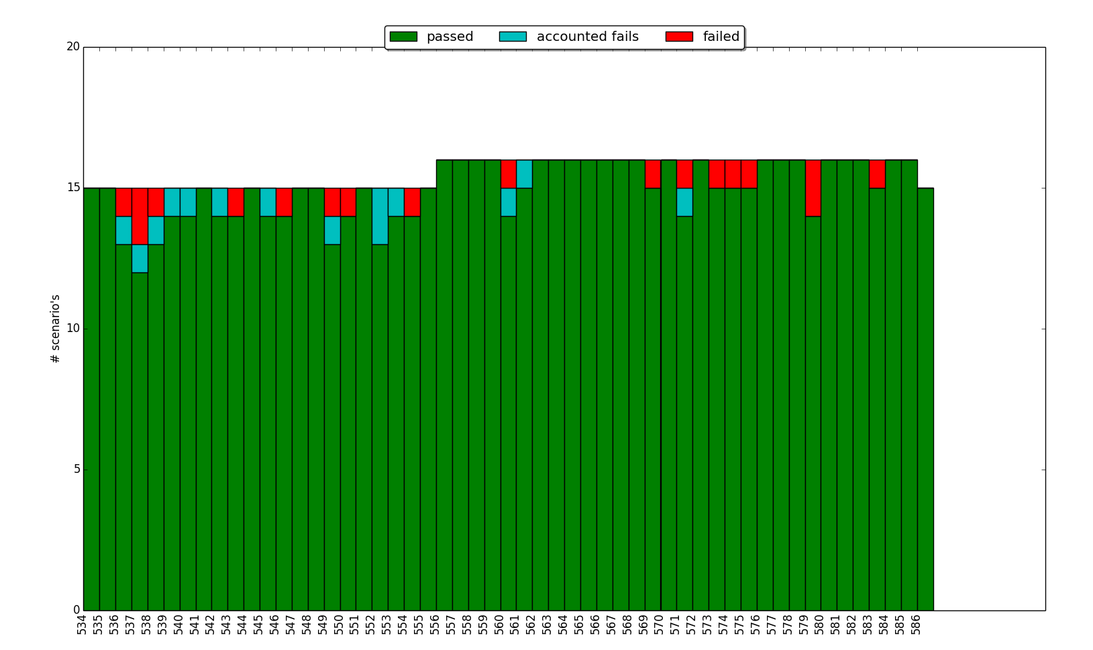
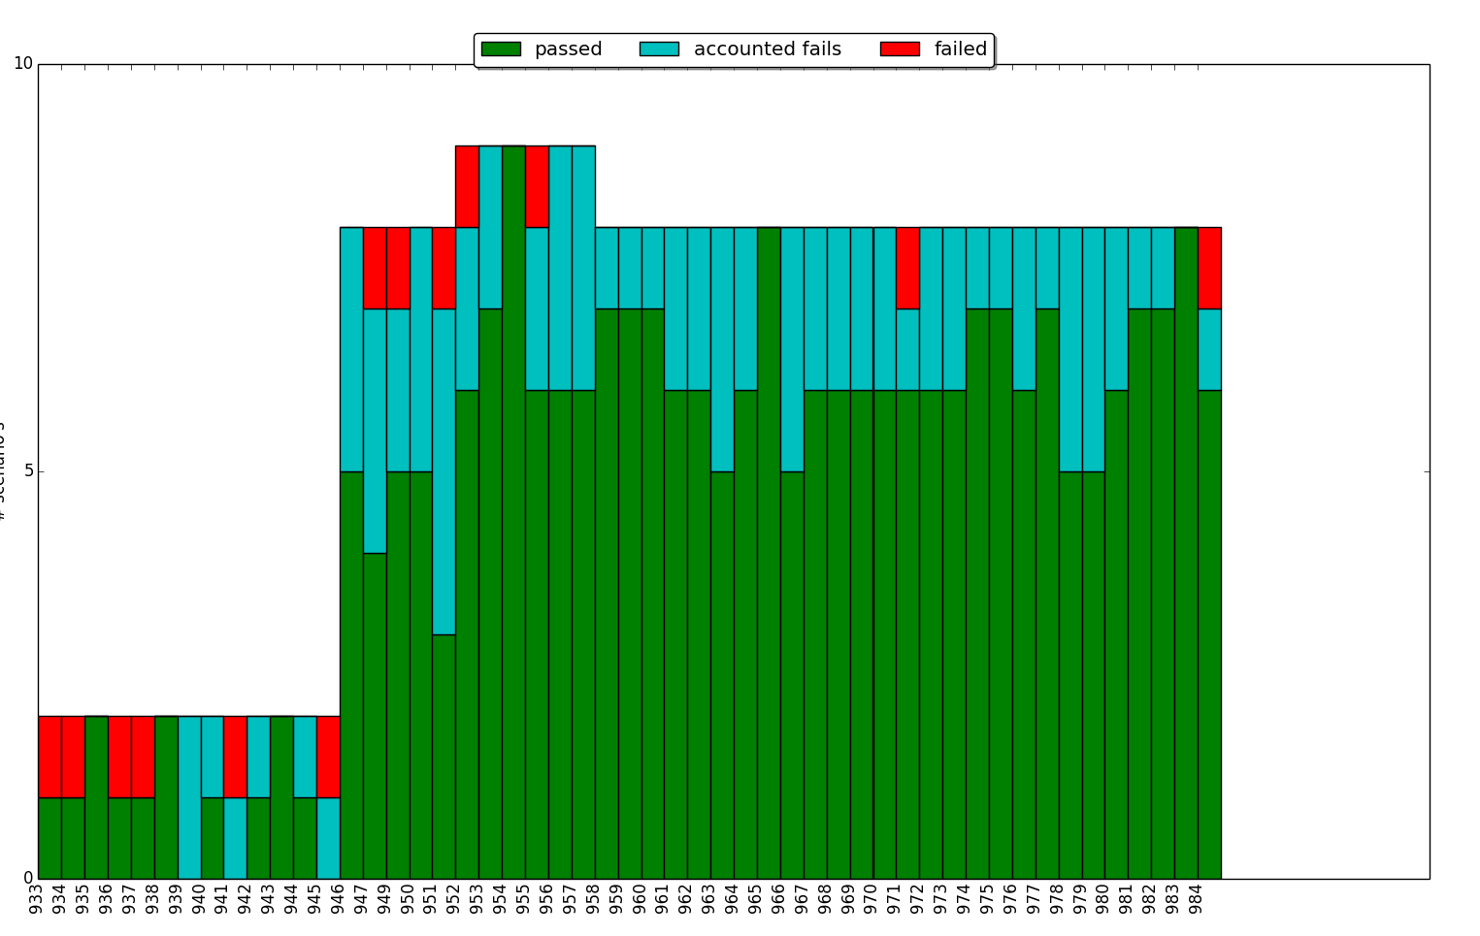
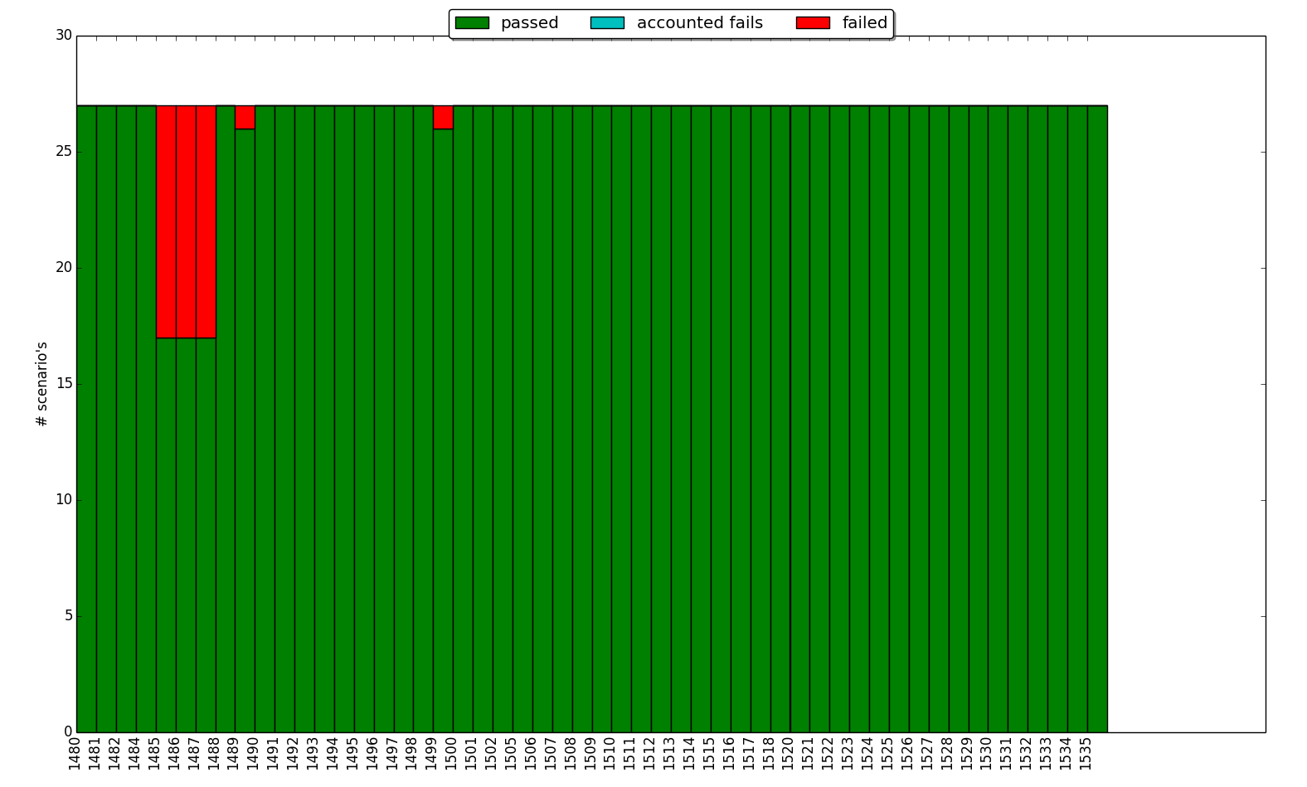
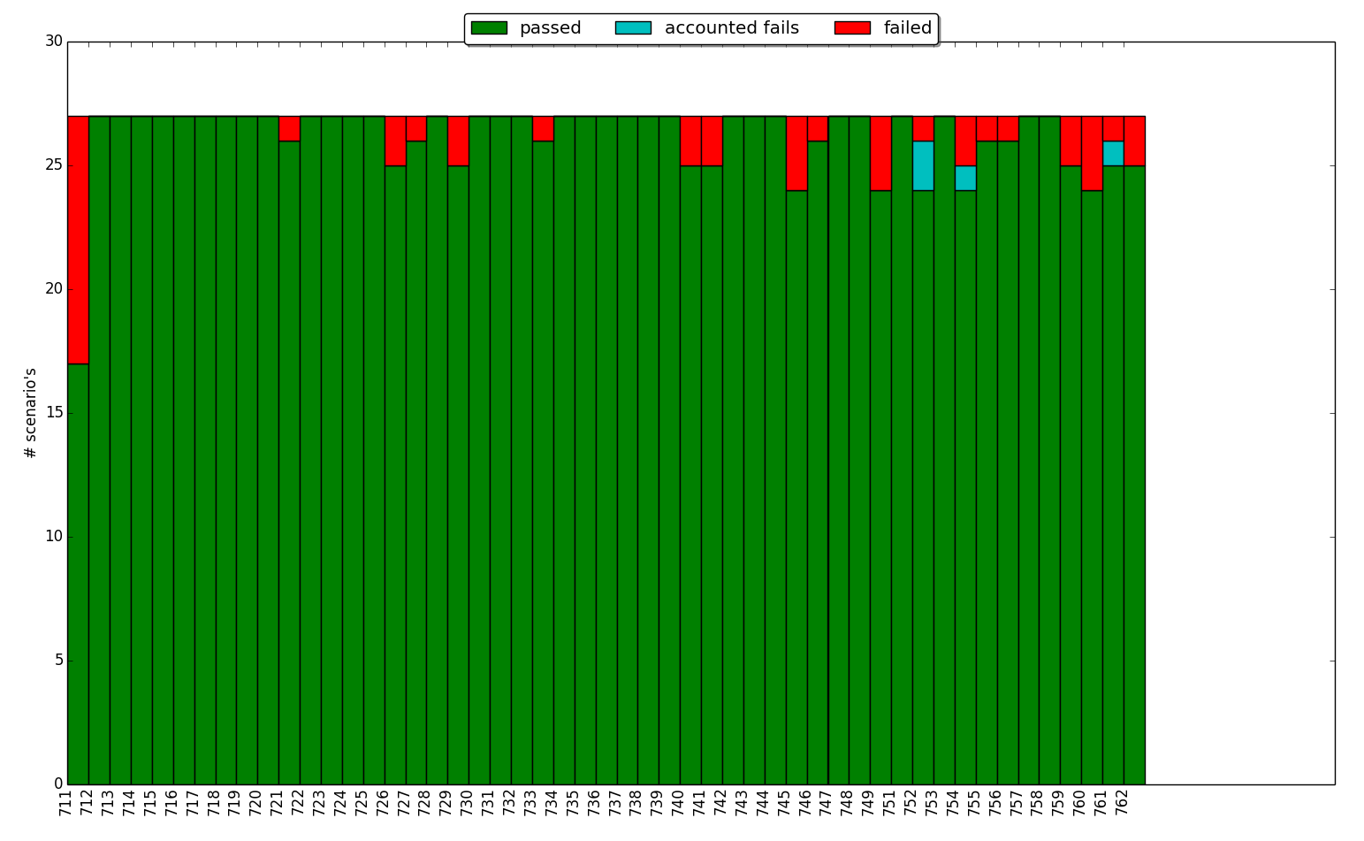
Reliability
Insight
Dataflow
Dataflow E2E

Slide 13
How we do did it
Notes:
M: Add uGrow logo, Specta/Expecta to make unit testing nice and easy
Calabash for BDD -> verification/integration testing

Slide 14
Learnings
Test speed and fast feedback is very important and should be maintained at all cost
Tests should be isolated and should not depend on each other
Different test levels are important to rule out certain unstable factors
UI Testing in iOS is unstable
Notes:
M: Unstable frameworks, isolated testing, test levels, test duplication, proper spec implementation (NO SLEEP), Do’s and Don’ts

Slide 15
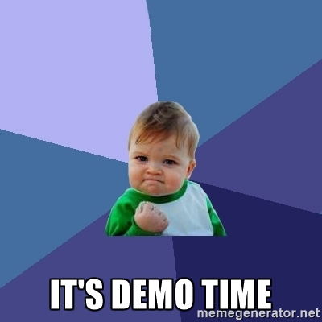
How we now think we should do it
Notes:
J&M: What we would do now in a new project & try to integrate in current projects based on our learnings
And: Swift compatibility of course
Proper use of Rspec style testing -> live pairing session
Cucumberish -> create using live templates: Check: Xcode or AppCode
Refactor tools & code generation is very important: Appcode vs Xcode
AnagramKata/ TODO list with filter?
Integration with connected devices? -> getting measurements from camera
What to demo?? Something CDP related??

Slide 16
Our new approach
Cucumberish
KIF (Keep It Functional) for UI testing
Quick for Rspec style
Nimble for descriptive matchers
Manual mocking (at least for now)
Notes:
J&M? Peripheral integration

Slide 17
Caveats to our new approach
Not really black box testing
Real UI testing still unstable
Cucumberish not widely adapted
No easy mocking in microtests
Notes:
J&M? Peripheral integration

Slide 18
What’s Next
Improve, extend Cucumberish
Actually start using this in our projects
Notes:
J: Peripheral integration

